Slide 1

Clustering Project
Uday Bagaria, Peherr Shah, Aarav Gandhi
Notes:
Aarav-

Slide 2
Project Goal
Analyze user behavior and engagement.
Group users into distinct archetypes.
Use SQL to extract activity metrics.
Apply clustering to find patterns.
Create actionable user profiles.
Inform strategies to improve engagement.
Notes:
Aarav- The project goal is not just to analyze and group users but to derive practical and strategic insights from the data. By combining SQL, clustering, and user profiling, the project aims to enhance the platform's ability to understand its audience and tailor features to improve engagement and satisfaction.

Slide 3
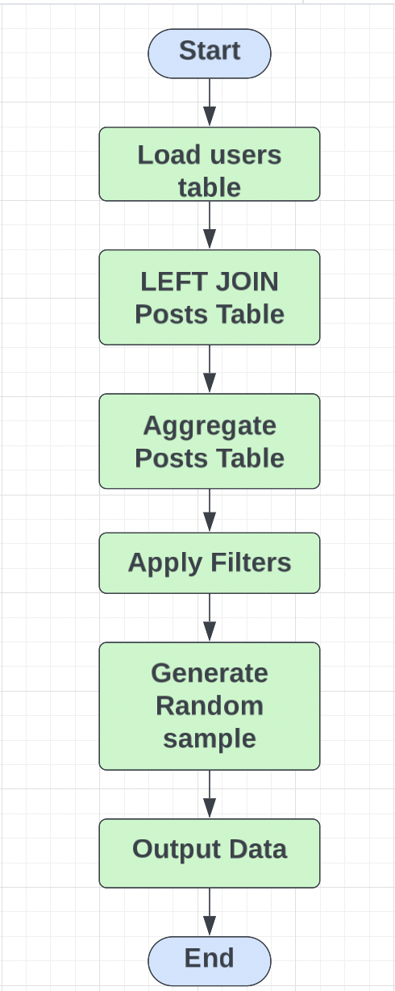
What the SQL code did
1. Extracted 1000 random users.
2. Queried data from Users table.
3. Used LEFT JOIN to merge tables.
4. Identified behavioral patterns and attributes of the users
5. Aggregated post data (questions, answers, comments).
6. Filtered users with missing reputation.
7. Randomized results using ORDER BY NEWID().
Notes:
Peherr

Slide 4







Why we chose these columns?
Reputation: Measures user influence
Comments: Shows engagement depth.
Questions/Answers: Reflect user role (learner/contributor).
Account Age: indicates User loyalty
Up/Down Votes: Highlights user perception.
Random Sampling: Ensures unbiased selection.
Notes:
Peherr- 1. Reputation and Engagement
Reputation:
A user’s reputation reflects their credibility and contributions within the platform.
High-reputation users are likely seasoned contributors, while low-reputation users might be new or infrequent participants.
Engagement Metrics (Questions, Answers, Comments):
These metrics help distinguish between different user types:
Learners: Users asking many questions but contributing few answers.
Experts: Users with more answers than questions.
Observers: Users with low activity across all metrics.
2. Account Age
Why Transform "Creation Date" into Account Age?
The account age provides a time-based perspective on user behavior. For instance:
Older accounts may indicate long-term loyalty or a deep understanding of the platform.
Newer accounts might represent recent adopters, still exploring or onboarding.
This helps identify clusters like "Seasoned Contributors" vs. "New Learners.
3. Upvotes/Downvotes
Significance:
Upvotes and downvotes reflect how the community perceives a user's contributions.
Users with more upvotes are likely providing valuable content, while those with higher downvotes might be posting lower-quality material or controversial content.
How It Aids Clustering:
Helps identify clusters like:
"Community Favorites" (users with consistently high upvotes).
"Controversial Contributors" (users with notable downvotes alongside activity). 4. Random Sampling
Why Use Random Sampling?
Prevents overrepresentation of specific user types, such as highly active or long-term users.
Ensures that the dataset is diverse and balanced, representing a fair cross-section of all user types.
Outcome:
Provides a robust foundation for clustering, ensuring the resulting archetypes are both meaningful and representative of the broader user base.

Slide 5
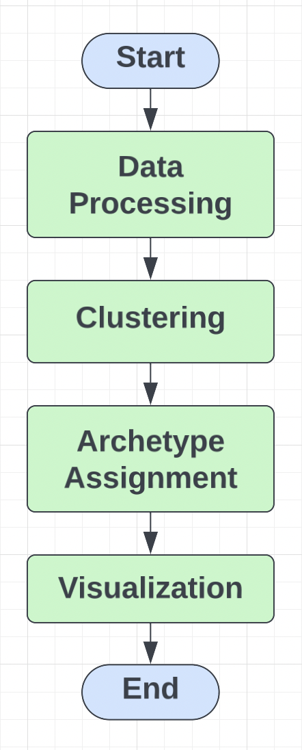
Python Analysis for User Clustering
Data imported and cleaned for analysis
Features normalized for clustering process
Single and complete linkage clustering used
Cluster profiles analyzed using feature means
Archetypes assigned to clusters with logic
Visualized data with bar/scatter plots
Notes:
Aarav- This structured approach—from data preprocessing to visualization—enabled the creation of distinct, actionable user profiles that could directly inform strategies to enhance engagement and user experience on Math Stack Exchange.
The right diagram:
Data processing- Used data processing to clean and normalize the data to ensure accuracy and comparability.
Clustering- Used hierarchical clustering methods (single and complete linkage) to form user groups
Archetype assignment- Used this to define meaningful user profiles based on feature means and clustering characteristics.
Visualization- Communicating the insights effectively through charts and plots, bridging the gap between technical analysis and actionable insights.

Slide 6
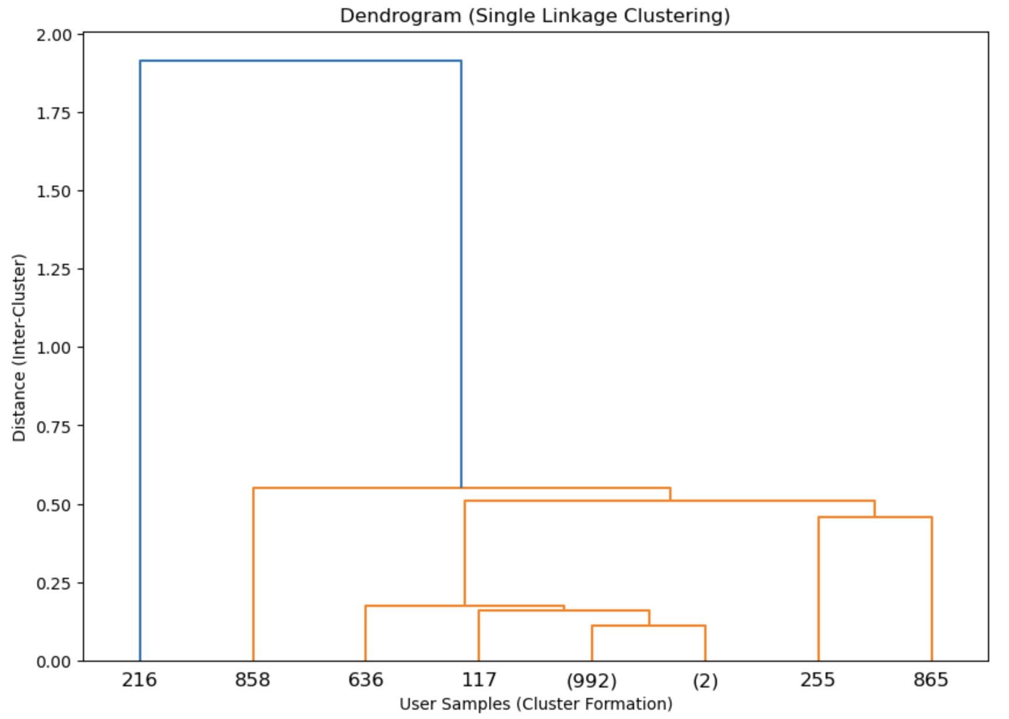
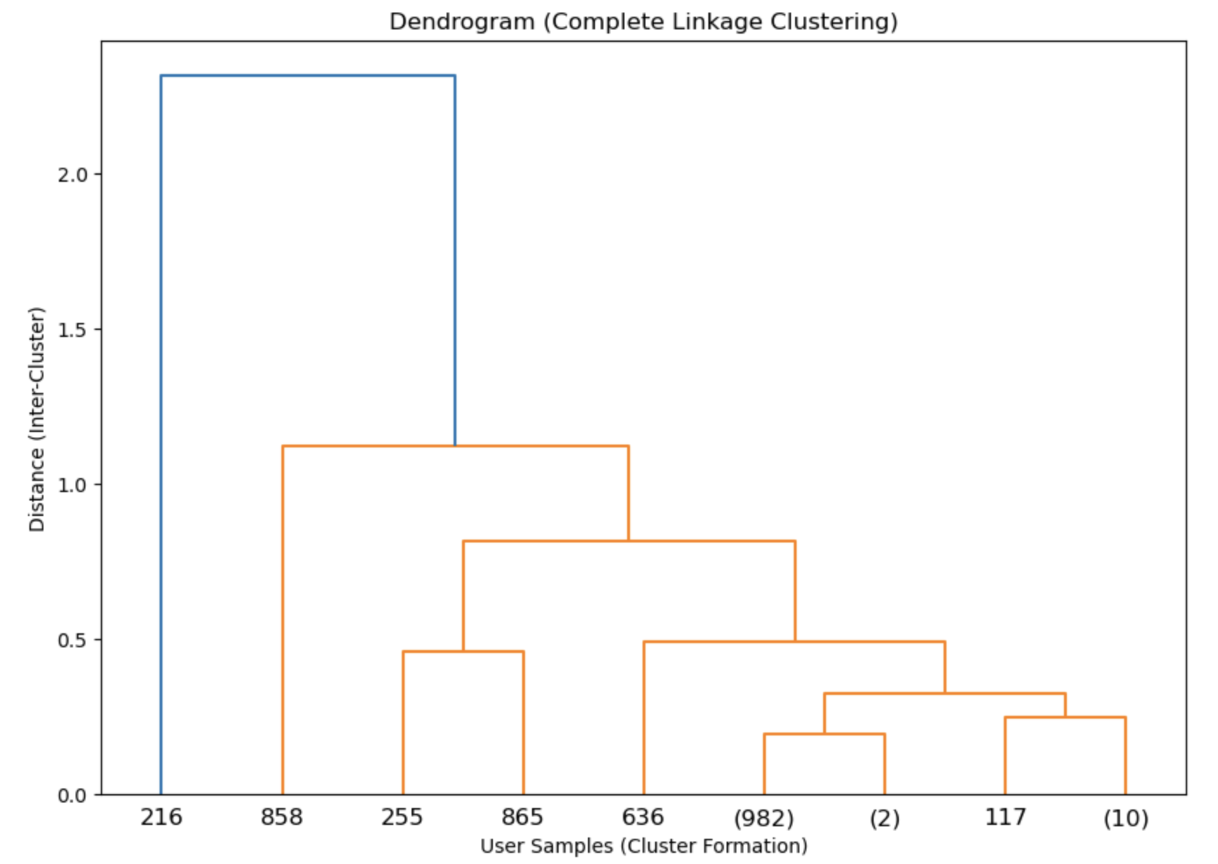
Clustering Methods: Single and Complete Linkage
Single linkage merges clusters based on shortest distance
Complete linkage merges clusters based on maximum distance
Both methods cluster based on user features
Compared results to identify stable archetypes
Four clusters identified in both methods
Notes:
Aarav- Single linkage merges clusters based on shortest distance which results in elongated, loosely formed clusters.
Complete linkage merges clusters based on maximum distance which forms compact and well-separated clusters.
As you can see in the dendograms, the single linkage dendogram shows loosely grouped clusters whereas the complete linkage dendogram highlights distinct and compact clusters
After analyzing both the dendograms, we concluded that complete linkage produced more meaningful clusters for analysis because it is represents a more compact and distinct cluster, it shows better representation for user behavior, it avoids chain effect, and it is more suitable for this dataset.

Slide 7
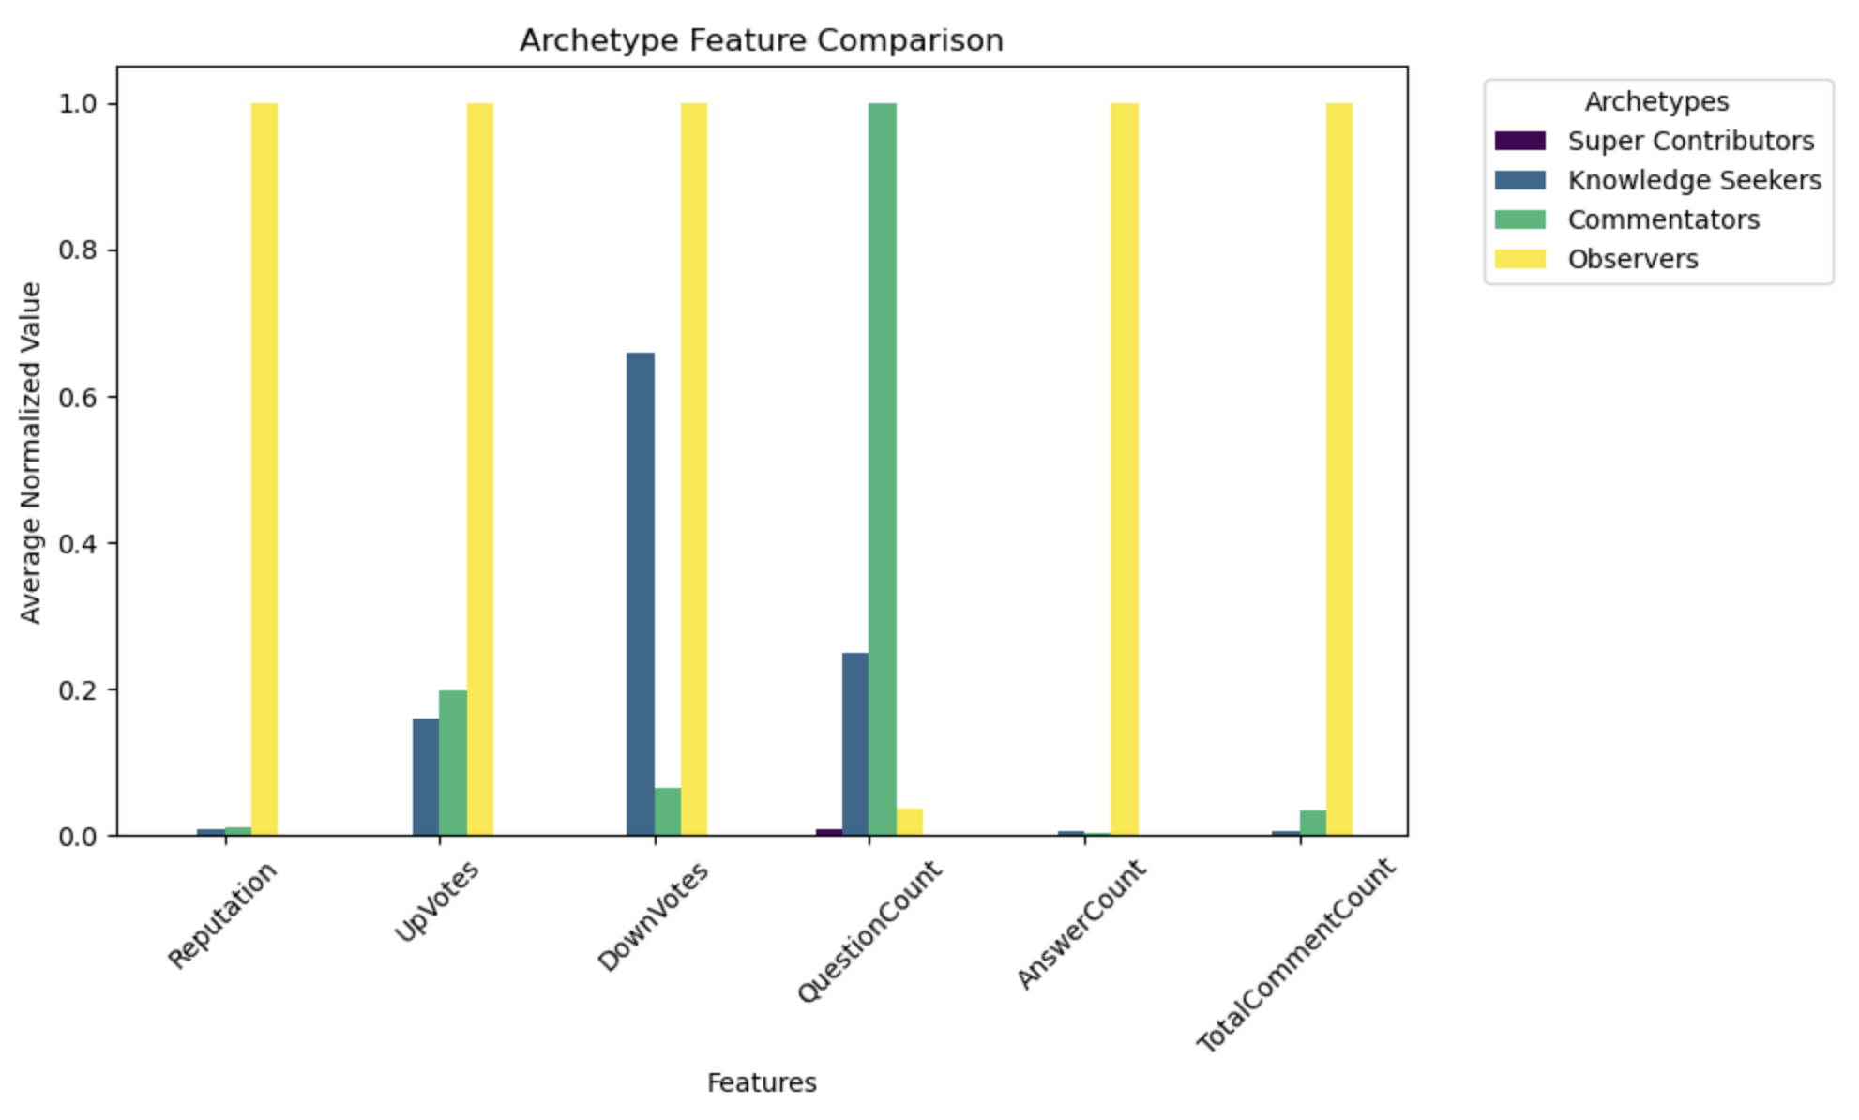
Assigning Archetypes to Clusters
Used feature means for archetype logic
Cluster 0: "Knowledge Seekers" (many questions)
Cluster 1: "Engaged Commenters" (comments-focused)
Cluster 2: "Super Contributors" (active users)
Cluster 3: "Observers" (low engagement)
Notes:
Aarav- The clustering process revealed four distinct archetypes based on user behavior. Each archetype was defined by analyzing the average normalized values of key features.
Super Contributors:
High levels of engagement, with the highest scores in UpVotes, AnswerCount, and Reputation.
These users are likely experienced contributors who provide high-quality answers and earn community trust.
Knowledge Seekers:
High QuestionCount but low UpVotes and AnswerCount.
These users primarily come to the platform to ask questions, seeking knowledge rather than contributing answers.
Commentators:
High levels of TotalCommentCount and moderate UpVotes.
These users engage in discussions and clarifications through comments rather than asking questions or answering.
Observers:
Low activity across all metrics, including Reputation, UpVotes, QuestionCount, and AnswerCount.
These users likely browse the platform without actively engaging.

Slide 8
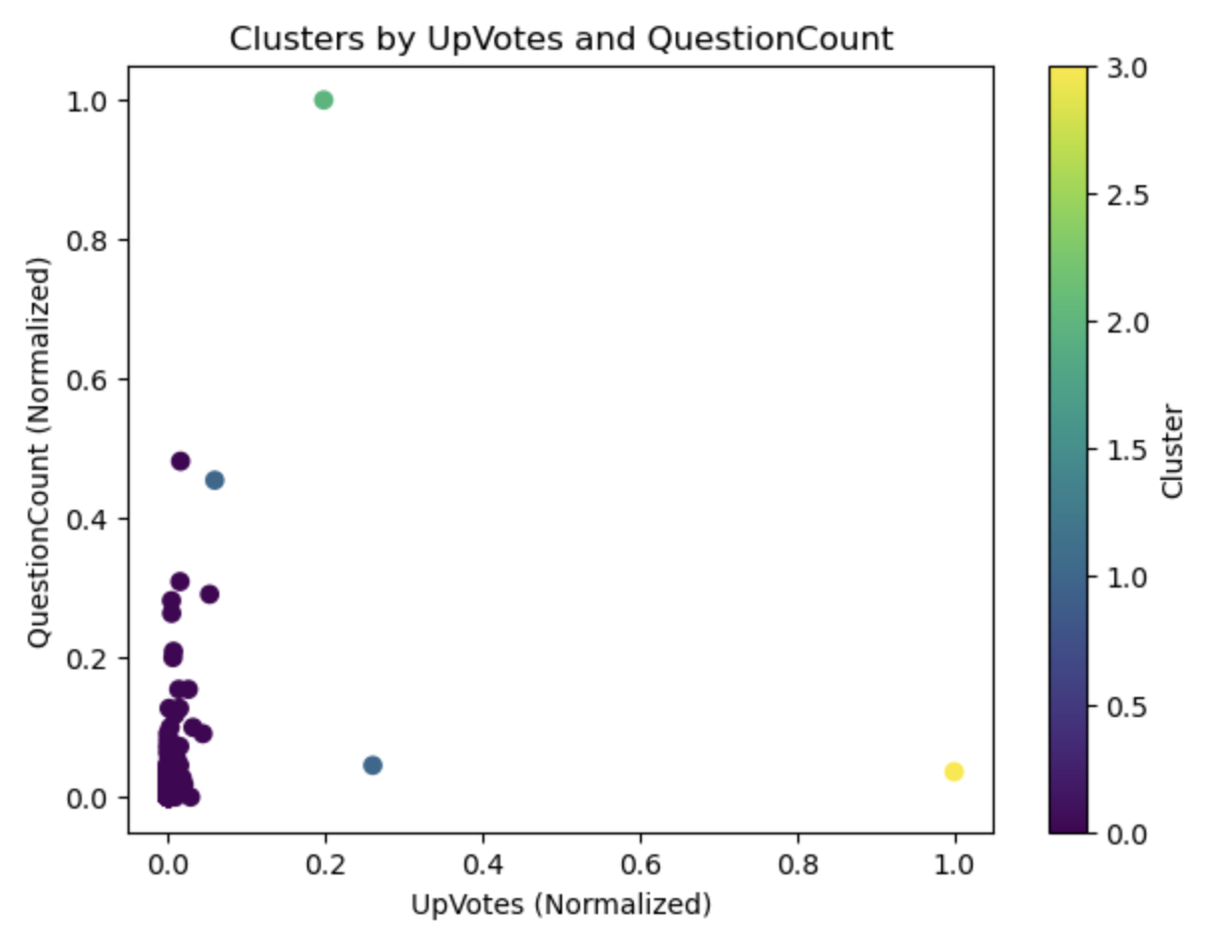
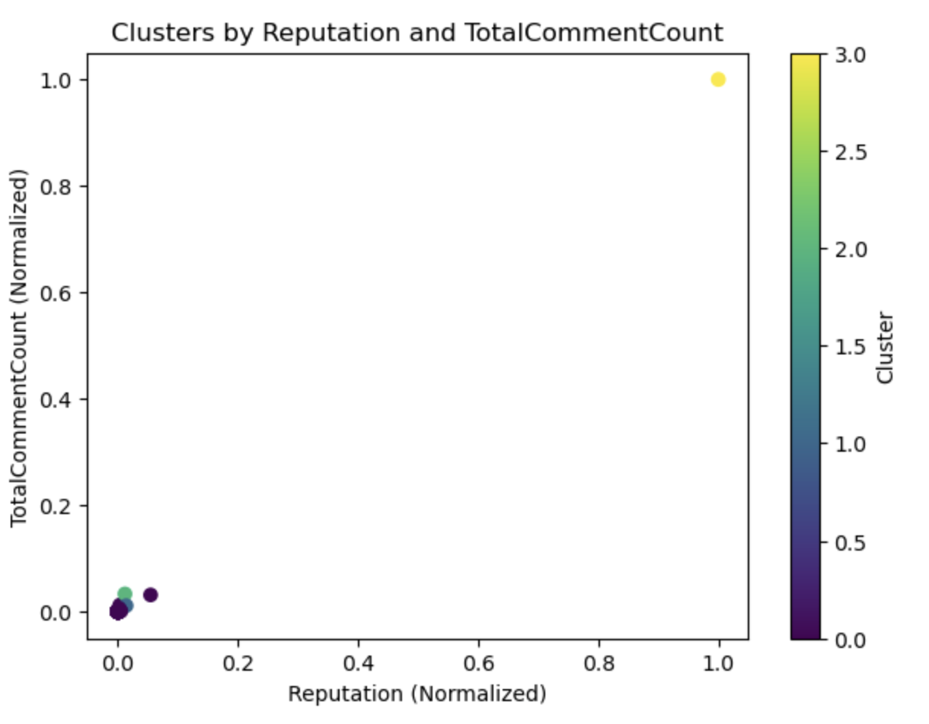
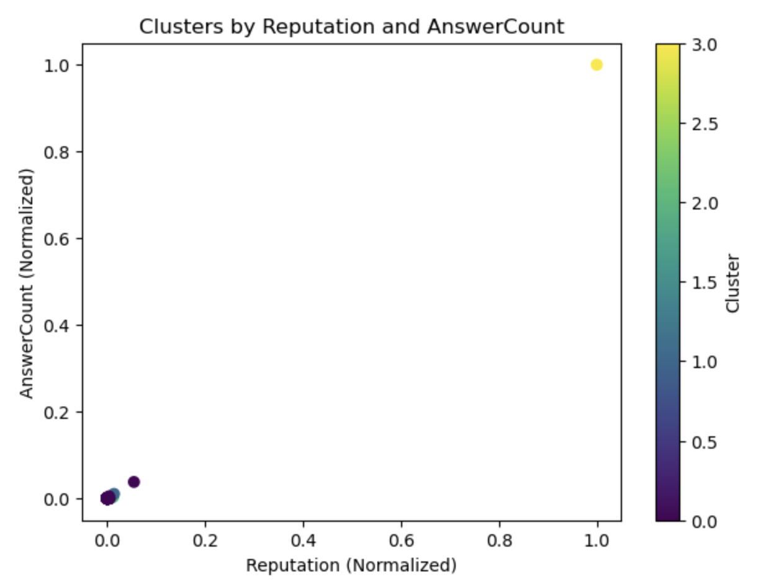
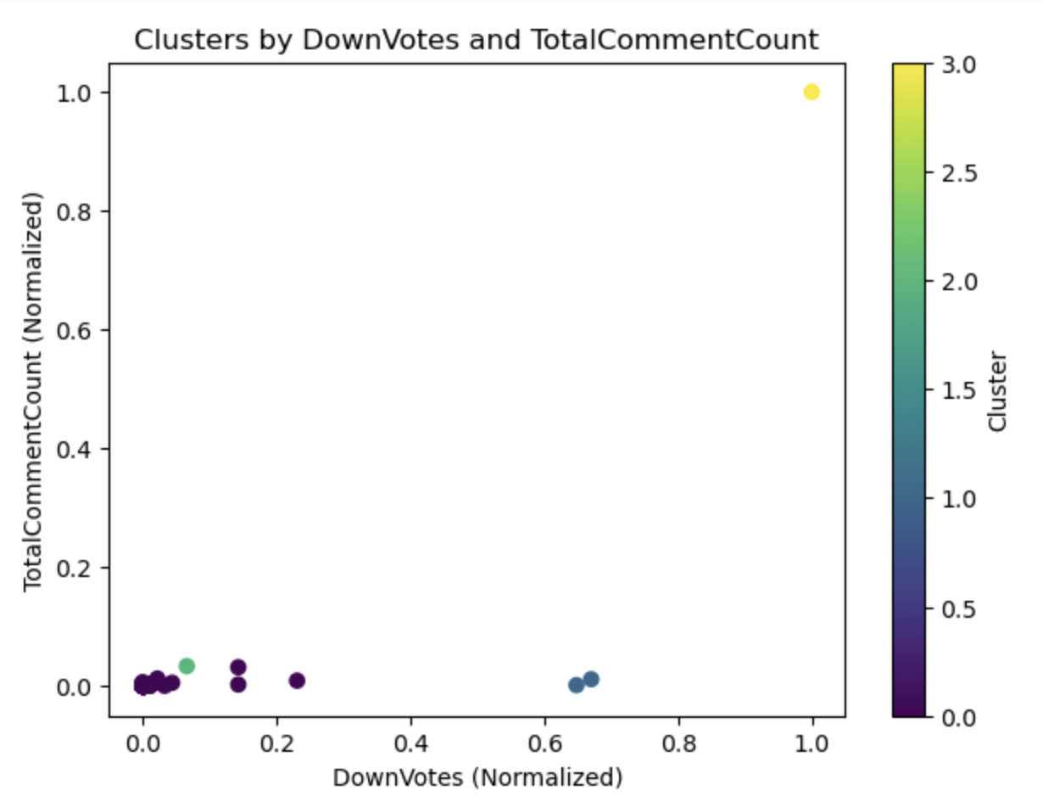
Scatter Plot Insights
Visualize user behavior across features
Example: Reputation vs. QuestionCount
Highlights activity levels and engagement
Shows cluster separations and overlaps
Supports archetype conclusions with evidence
Notes:
Peherr-
Scatter plots for single linkage and complete linkage visually show the clustering results, with users plotted based on normalized features (e.g., Reputation, UpVotes).
Clusters are color-coded to represent the four archetypes.
The complete linkage scatter plot highlights tighter, well-separated clusters, making the archetypes more distinct.

Slide 9
Key Python Steps
Feature normalization for clustering algorithms
Single and complete linkage clustering models
Mapped cluster IDs to archetypes
Used pandas for summary statistics
Visualized results using matplotlib
Notes:
Peherr

Slide 10
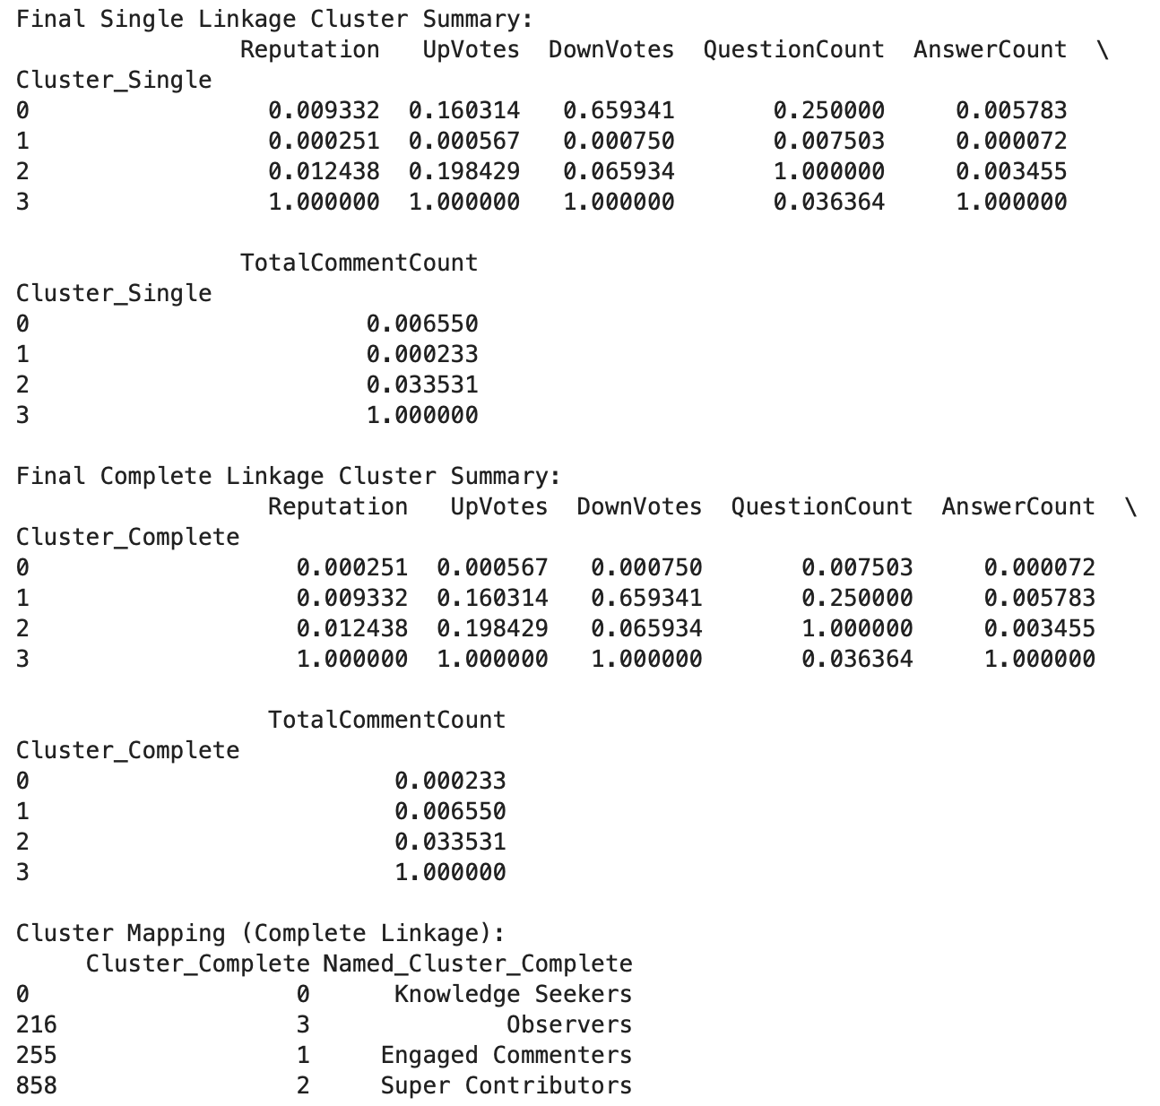
Insights and Final Takeaways
Analyzed user behavior and engagement: Normalized metrics revealed key patterns in activity.
Grouped users into distinct archetypes: Clustering defined clear groups like Super Contributors and Observers.
Extracted activity metrics via SQL: Leveraged structured data to inform clustering analysis.
Applied clustering to find patterns: Single and complete linkage consistently highlighted user behaviors.
Created actionable user profiles: Cluster summaries provided a foundation for tailored engagement strategies.
Informed strategies for platform improvement: Insights guide actions to increase participation and reward contributors.
Notes:
Peherr

Slide 11
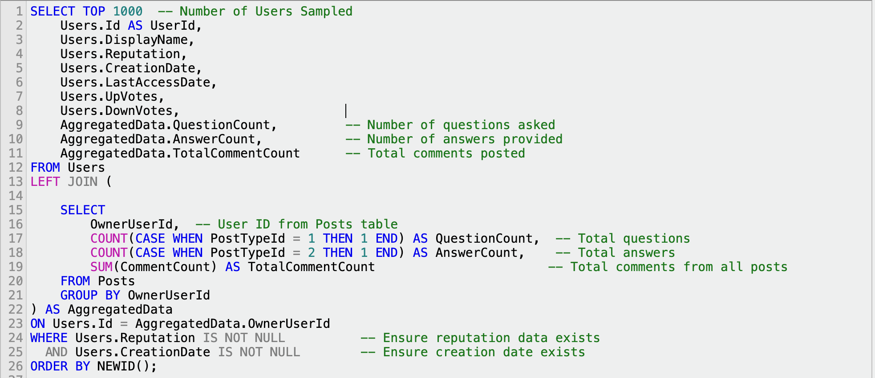
Appendix - SQL

Slide 12
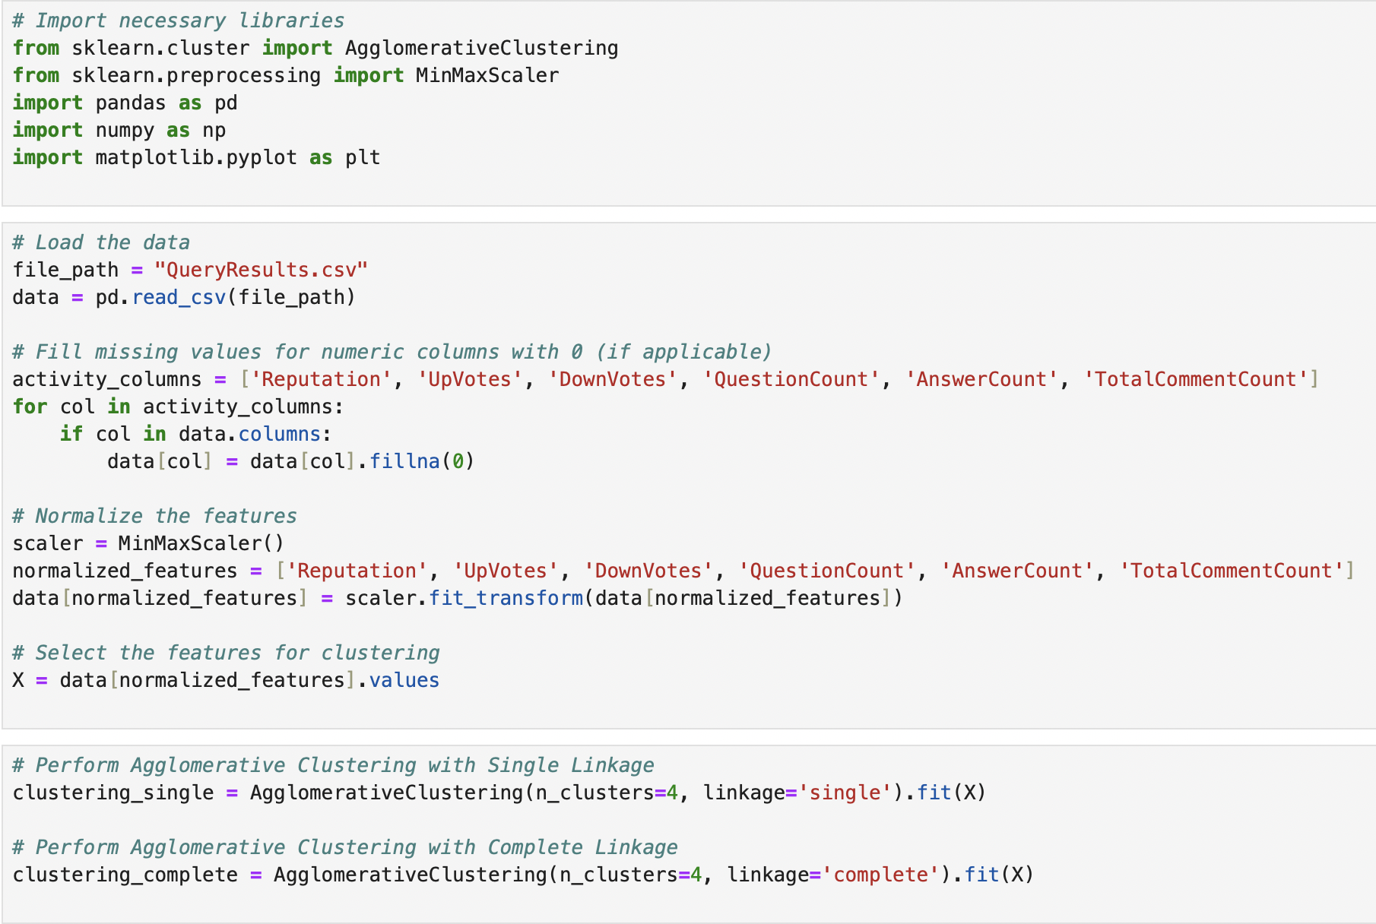
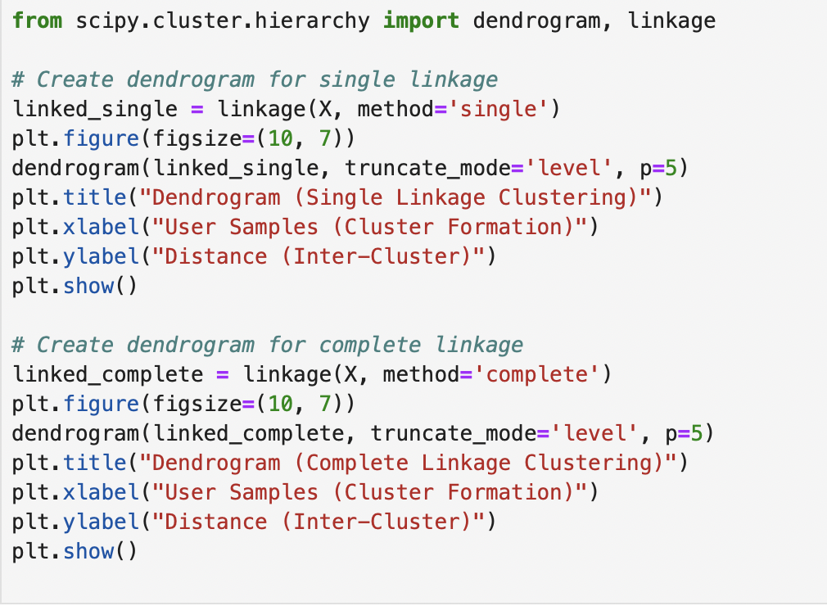
Appendix - Python

Slide 13
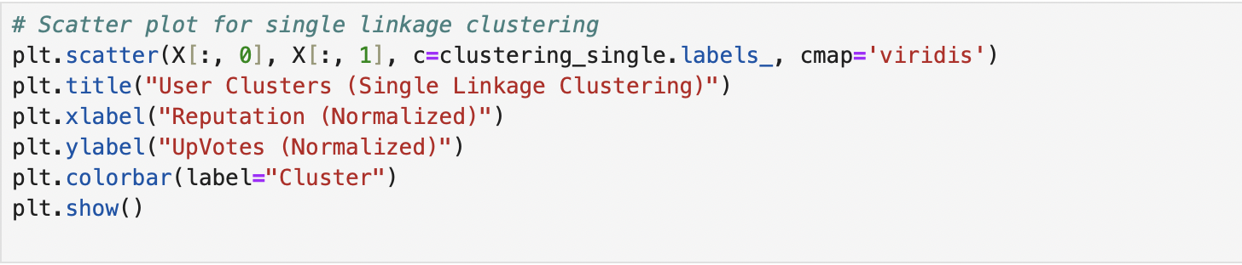
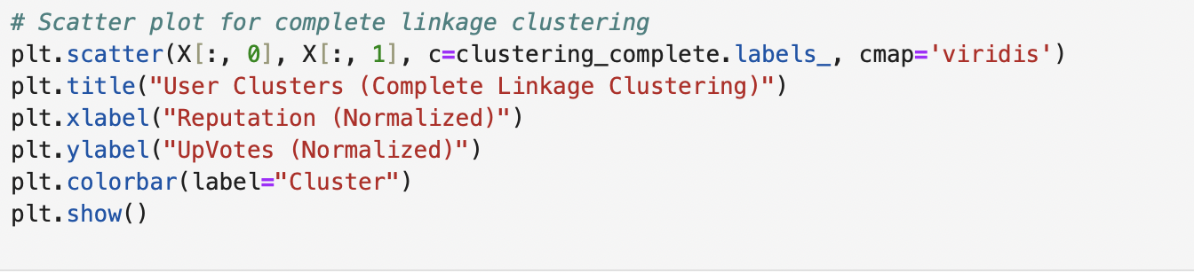
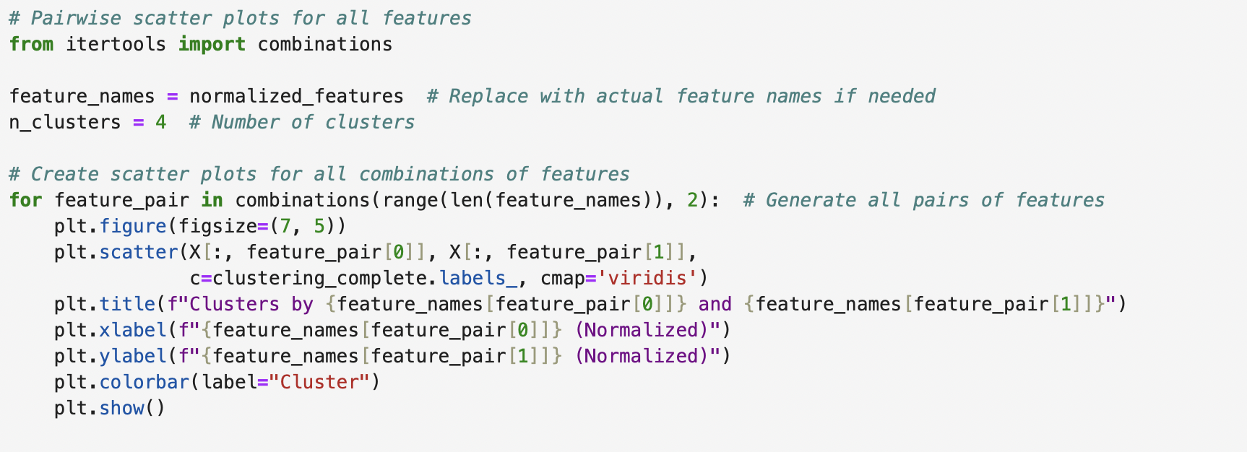

Slide 14
